Slide 1

SMART PARKING SYSTEEM
TEAM MEMBERS:
Lakki N, Manjunath Rathod, Kaushik P, Pratik Medikinal, Manikanta Askani
Innovation and Design thinking laboratory
Department: ISE
Guide: Ms. Jayashree M

Slide 2
TABLE OF CONTENTS
Introduction
Problem Definition
Design Thinking Process
Discovery and Empathy
Ideation and Conceptualization
Prototyping and technical development
Review and Documentation

Slide 3
INTRODUCTION
Due to the increasing number of vehicles, parking management has become a major problem in cities. A Smart Parking System helps in efficiently managing parking spaces by automatically detecting available and occupied slots using sensors and modern technology. This system reduces traffic congestion, saves time and fuel, and improves the overall parking experience.

Slide 4
PROBLEM DEFINITION
In urban areas, the rapid increase in the number of vehicles has led to serious parking management issues. Traditional parking systems do not provide real-time information about available parking spaces, causing drivers to spend more time searching for parking. This results in traffic congestion, fuel wastage, increased pollution, and user inconvenience. Hence, there is a need for an automated and efficient system that can monitor parking slot availability in real time and provide accurate information to users to improve parking management.

Slide 5
DESIGN THINKING PROCESS
The project follows the Design Thinking approach, which includes:
Discovery and Empathy
Problem Definition
Ideation and Conceptualization
Prototyping
Review and Documentation
This approach helps in creating a user-centered and practical solution.

Slide 6
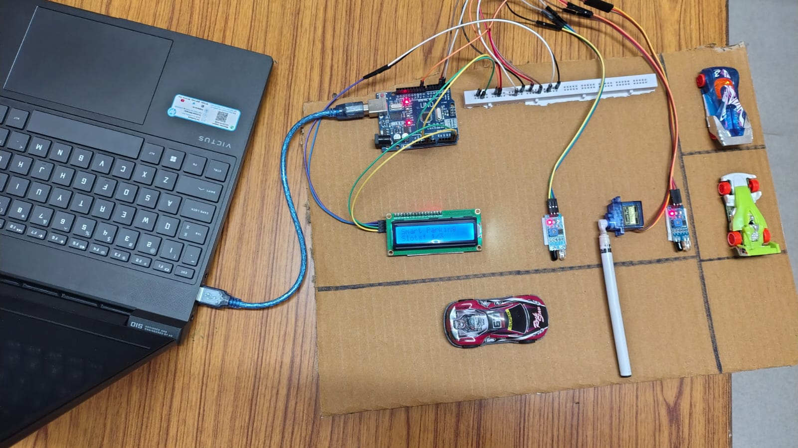

Slide 7
DISCOVERY AND EMPATHY
Through observation and interaction with vehicle users and parking managers, it was identified that finding an available parking space is time-consuming and frustrating, especially in crowded areas. Users often face problems such as lack of real-time parking information, traffic congestion, and fuel wastage. Parking operators also struggle with inefficient space utilization and manual monitoring. Understanding these user difficulties helped in identifying the need for a smart, automated parking system that provides real-time parking availability and improves user convenience.

Slide 8
IDEATION AND CONCEPTUALIZATION
Based on user needs, multiple ideas were brainstormed such as manual parking guidance, display boards, and mobile-based parking information. The final concept selected was a smart parking system that uses sensors to detect parking slot availability in real time and displays the information to users, enabling efficient parking and reducing congestion.

Slide 9
PROTOTYPING AND TECHNICAL DEVELOPMENT
Prototype Development & Iteration: Developing a functional prototype of the smart parking system using sensors and LCD display, and improving the design based on testing and performance results.
Teamwork: Collaborating on different aspects of the project such as sensor integration, Arduino IDE programming, and system setup to ensure accurate parking slot detection and display.

Slide 10
REVIEW AND DOCUMENTATION
Review: Regularly evaluating the system performance, sensor accuracy, and overall functionality to identify improvements and ensure reliable operation.
Documentation: Recording all project details including system design, block diagrams, circuit connections, algorithms, and user guidelines in the final report.

